Slide 1
Group 1 Project #2 - System Lifecycle & Real Time Execution
Ahmed Sharif, Anmol Talwar, Ashish Maharjan, Benjamin Zhong, Constantinos Cleanthous

Slide 2
System Life Cycle

Slide 3
Goal - Recreate the Star Schema using [FileUpload].[OriginallyLoadedData] Table
Preliminary stored procedures
Create WorkFlowTable and related workflowtracking values
Create UserAuthorization Table
Drop Foreign Keys from Star Schema and then Truncate
Create new sequence object keys for all tables in [Project2].[Dim].
Alter Tables to accept new seq keys
Load Data from FileUpload Table
Create each stored procedures on its own
Then Combine all stored procedures together to create LoadStarSchema procedure
Print WorkFlowTable after Star Schema was uploaded

Slide 4
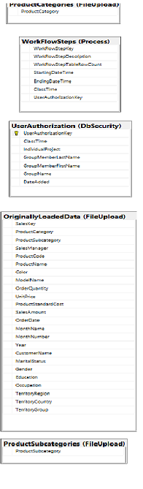
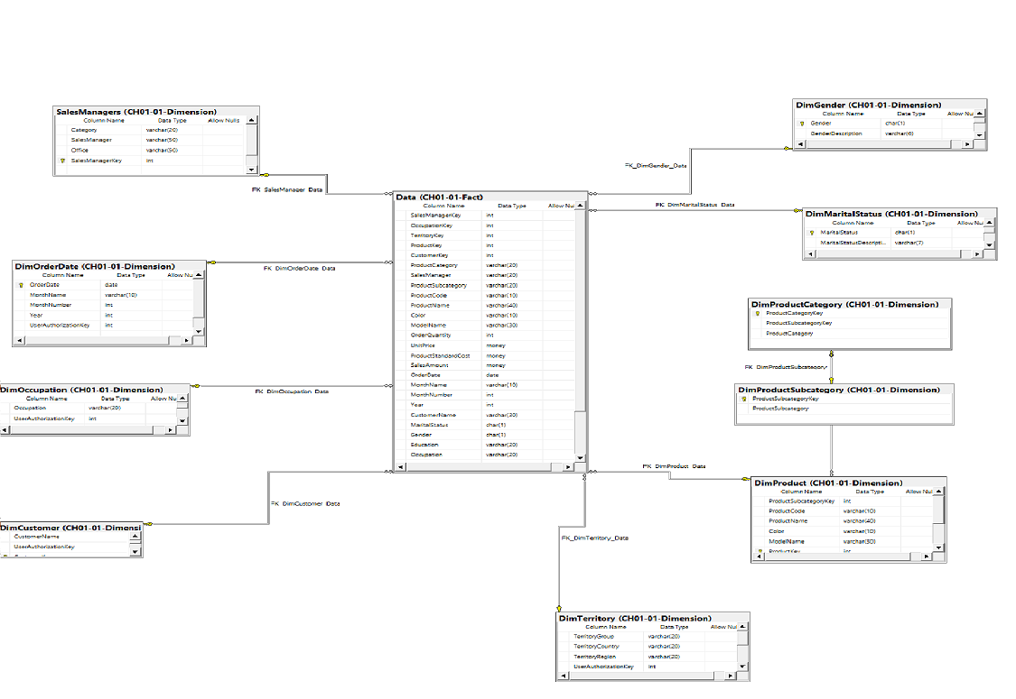
System Design

Slide 5
Development
Ahmed Sharif (Backup Project Leader)
Anmol Talwar
Ashish Maharjan
Benjamin Zhong (Project Leader)
Constantinos Cleanthous
Mention Dates, Assigned Procedures for everybody

Slide 6
Testing - WorkFlowStepTableRowCount
1. Prepare the Environment:
- Ensure the database and schemas Like Process, DbSecurity, etc. are correctly set up.
- Execute the schema and table creation scripts to prepare for data manipulation.
2. Initialize the Test Data:
- Populate the tables with initial data where necessary, or ensure that the procedures capable of populating data like CreateUserAuthtable are functioning as expected.
3. Execute Individual Procedures:
- Run each stored procedure individually. For example, begin with procedures like [Project2].[usp_WorkFlowStepCounter].
- Monitor the results and check that the WorkFlowSteps table is updated appropriately after each procedure is executed.
4. Check WorkFlowStepTableRowCount Updates:
- For each execution, the WorkFlowStepTableRowCount should reflect the number of rows processed or affected by the preceding SQL operation.
- Use SQL queries to verify the correctness of the WorkFlowStepTableRowCount entries against expected values.
5. Error Handling:
- Ensure that each procedure contains appropriate error handling to manage exceptions and rollback transactions where necessary, especially in cases where operations do not proceed as expected.
7. Log and Report:
- Enhance procedures to log significant events or errors into a separate logging table or file, which can be reviewed as part of the testing feedback.

Slide 7
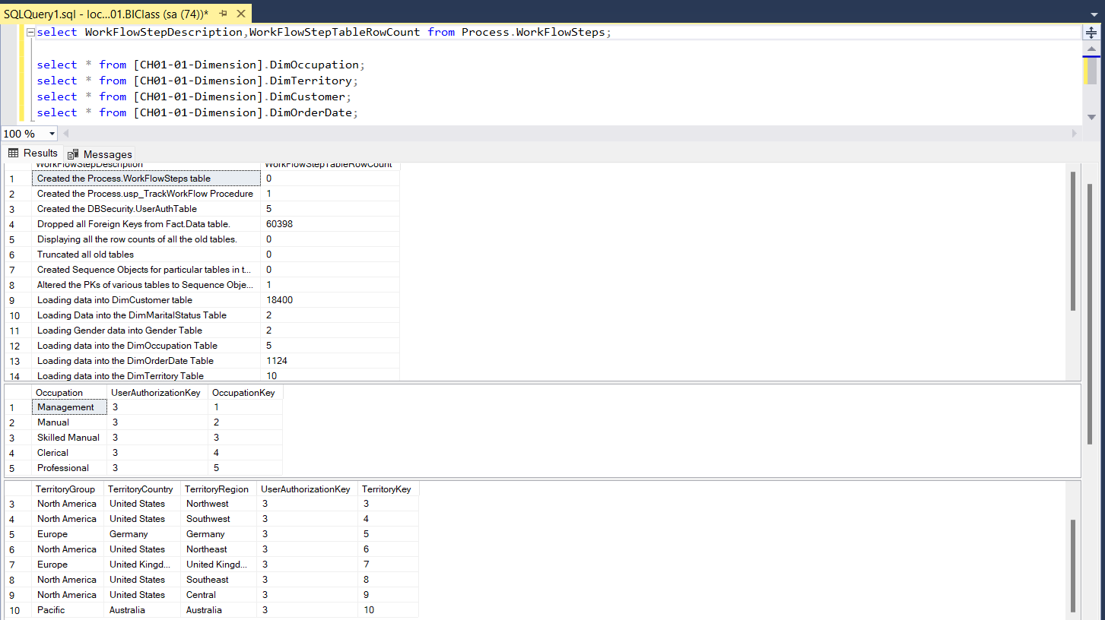

Slide 8
Real Time Execution with JDBC Library (Ahmed Sharif)

Slide 9
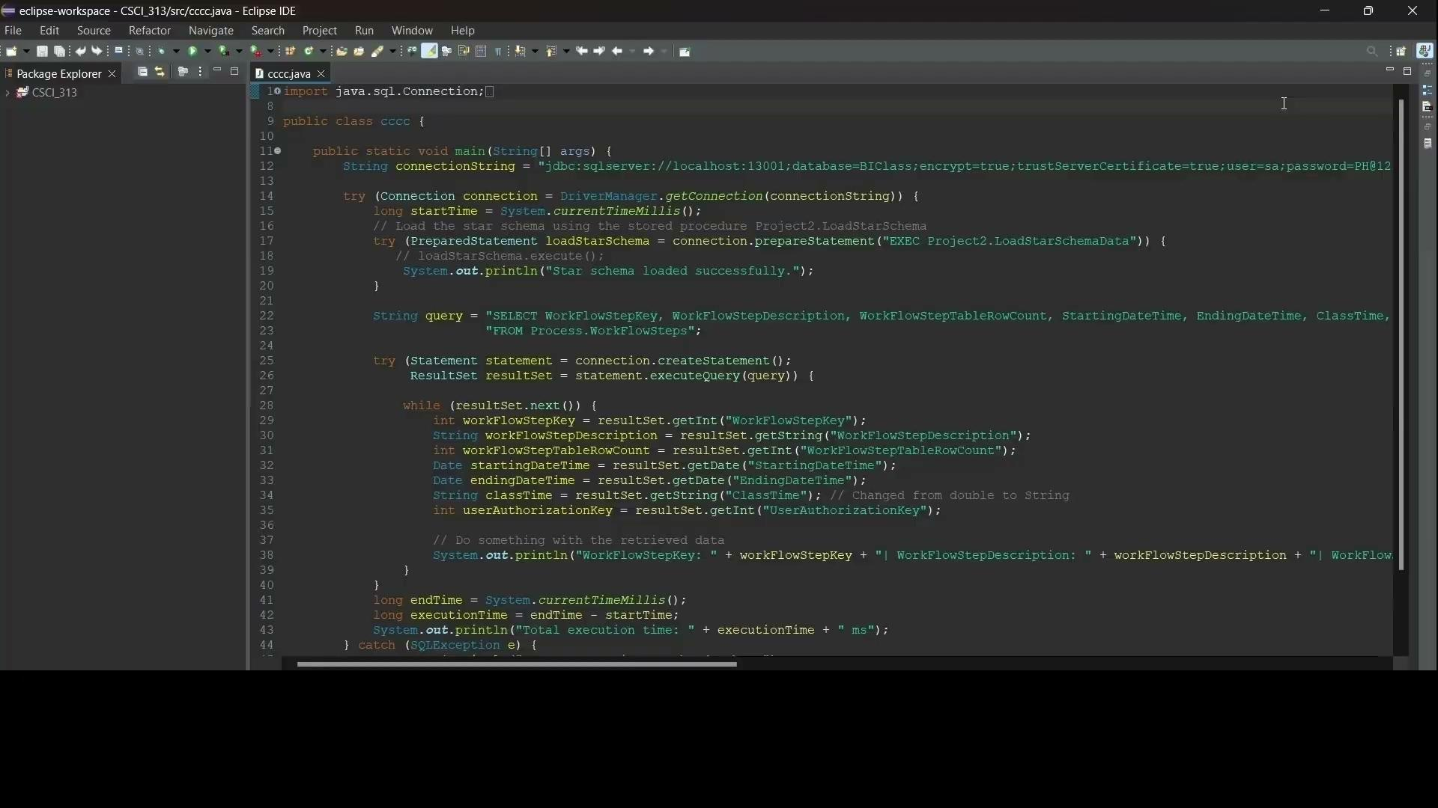
Real Time - Execution

Slide 10
Group 1

